Slide 1
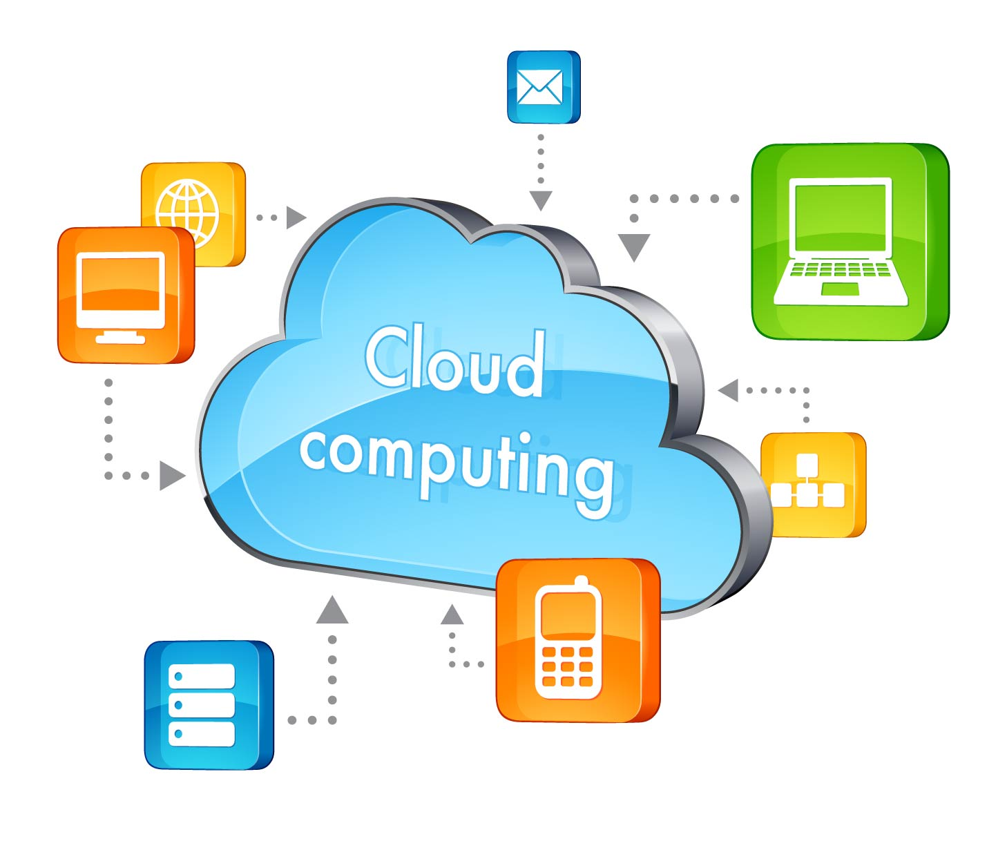
Cloud Computing
Prepared By
Nisarg Dave (14MCA12)
Harsh Mistry (14MCA20)

Slide 2
What is Cloud computing?
Definition:
Cloud computing is associated with delivering the hosted services on the Internet.
Services or models divided into 3 categories:
Infrastructure-as-a-Service (IaaS),
Platform-as-a-Service (PaaS)
Software-as-a-Service (SaaS).

Slide 3
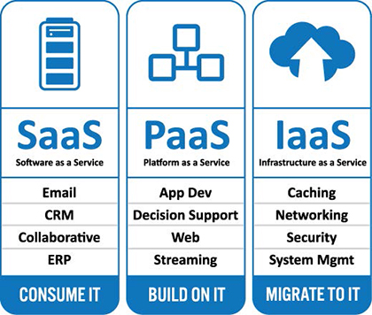

Slide 4
Specialized versions of 3 basic models
Storage as a service
Database as a service
Security as a service
Communication as a service
Integration as a service
Testing as a service
Process as a service

Slide 5
History of Cloud computing
Idea of cloud Computing is taken from 1970. Where IBM create a new OS called Virtual Machine. This concept is at that time called “Group Computing”.
1960 concept of Cloud Computing Given by J.C.R Licklider Give a new vision to world called “Cloud Computing world”.
in 1997 First time Could Computing term was describe by Prof. Ramnath Chellappa.
After that company got attention of Cloud and major Company create their cloud according to their requirement.

Slide 6
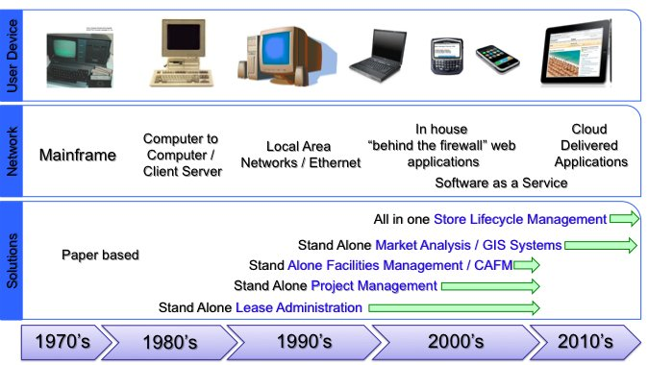

Slide 7
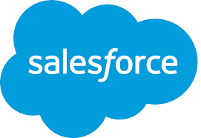
Development of Cloud computing
In 1999 “Salesforce.com” create first cloud. The concept was delivering application to end Use via Internet. And Company Store data in Cloud.

Slide 8
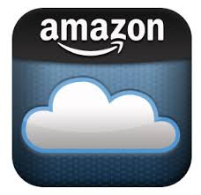
In 2002 Amazon is create second cloud and provide cloud based technology to user with own storage space.

Slide 9
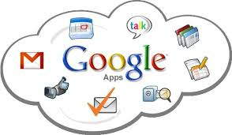
After that in 2006 google launch the google Docs Service which brought the power of Cloud Computing and share document to direct to end user.

Slide 10
Infrastructure as a Service (Iaas)
It is a kind of service model in which, the computing resources such as hardware, software , networks, server space and more are provided.
So that provider of cloud service need not to purchase or buy the peripherals which decreases the overheads of hosting services.
e.g Physical Computers,Virtual Machines (such as Oracle VMBox) ,software bundles, firewalls & more

Slide 11
Advantages of IaaS
No Investment: Already underlying hardware is used which supports the cloud services.
Cost Effective: As client uses the present hardware and softwares, investment cost is saved as well as client only pays for the resources which are used.

Slide 12
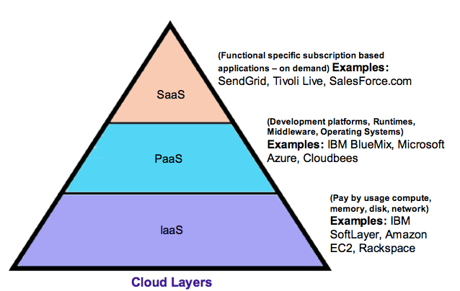

Slide 13
Platform as a service (Paas)
In this kind of model the cloud providers typically provide a platform
i.e Operating system which consist of packages of programming languages,databases and web services environment, Server software, tools for design & development.

Slide 14
Advantages of Paas
Stability: You have control over applications & configuration settings for hosting environment.
Quick testing and deployment: Development teams can try different configurations, multiple machines & different locations, to run stress tests and assess performance, compatibility, and response in ways that are impossible in a local environment.
And many more…..

Slide 15
Software as a service (Saas)
It is a kind of service model in which, Applications are provided by Vendor or Service provider typically on internet.
E.g Google Drive, excel, slides, docs.
Real time example , “Bank”
Maintains user data , allows security , netbanking service and much more.

Slide 16
Advantages of Saas
Auto updates and patches: Applications updated over the cloud reflect to common internet based service so easy for the users to instantly avail the benefits.
Compatibility: Users do not have to worry about configuration of their machine for using an application, as softwares run on remote machine all users can access it.
Global accesibility: Very obvious as no restriction is put so anyone can use the services.
And many more…..

Slide 17
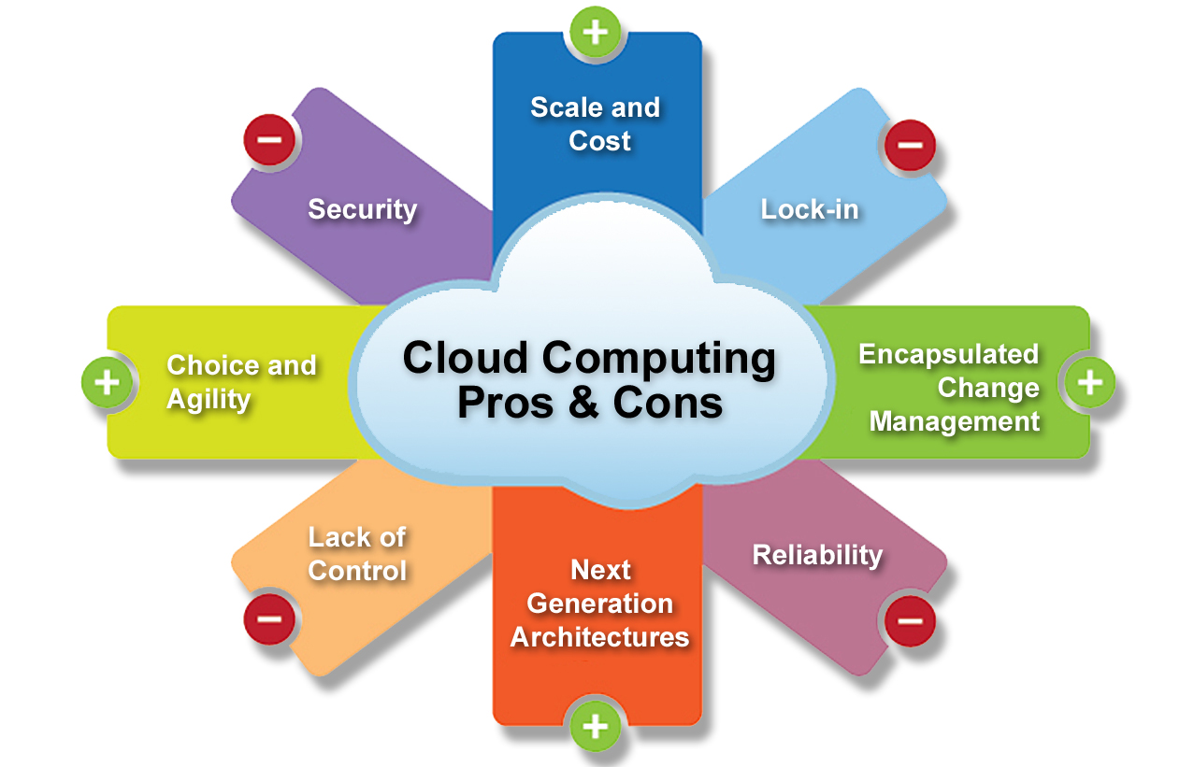

Slide 18
Some Terminologies
Lock –In: Lock-in is a situation in which a customer using a product or service cannot easily switch over to a competitor’s product or service.
e.g A Person faces a complexity of switching over data from one cloud vendor to other.
Issues can be Data Instability, data alteration.

Slide 19
Lock-In
Platform Lock-In
e.g
From Vmware to Xen
Tools
Lock-In
e.g Different vendors provide different tools
Data
Lock-In
e.g Where to put or switch data
For Data, see Cloud Computing Bill of Rights

Slide 20
Some Cloud Concepts & Terminologies
1) Cloud: Refers to an IT environment that is designed for purpose of remotely provisioning scalable and measured IT resource.
2) IT Resource: Could be either physical or virtual IT related artifact.
e.g Physical: Server
Virtual: Software or Program

Slide 21
Continued…
3) Cloud Consumer: Party which uses cloud based IT resources.
4) Cloud Provider: Party which provides cloud based resources.

Slide 22
Continued…
5) Scaling: It refers to handle increased or decreased usage demands.
Scaling
Horizontal Scaling
Vertical Scaling

Slide 23
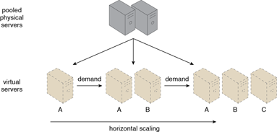
Horizontal Scaling:
Increasing or decreasing resources that are of same type.
Increasing the resources is called Scaling Out.
Decreasing the resources is called Scaling In.

Slide 24
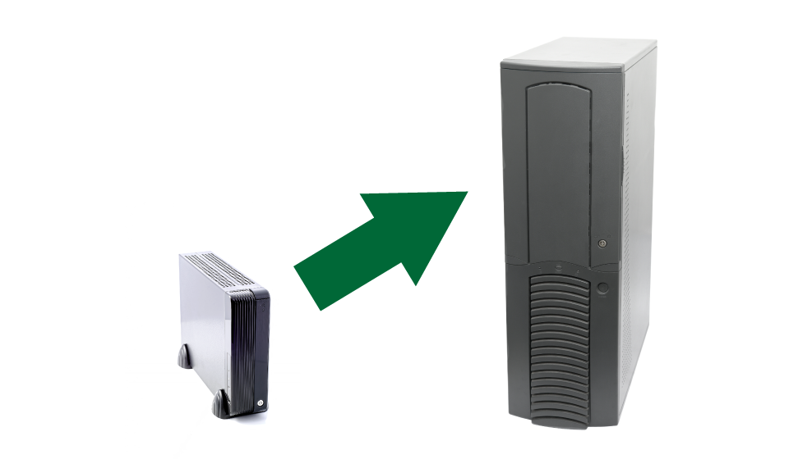
Vertical Scaling:
Increasing /decreasing resources based on higher or lower capacity.
e.g from Core i3 to Core i7 server is example of Scaling Up
Increasing the resources is called Scaling Up.
Decreasing the resources is called Scaling Down.

Slide 25
Cloud Based Operation System
Cloud OS is the term that is used for describe the lightweight operating system for the tablets or the computers. The system that access the web-based application and store and retrieve the data from the remote server.
Developed by GOOD OS LLC.
Simply OS that runs on a web browser and allow user to work some basic task without boot the whole system.
Design for the device that used to browse the internet like Net books, Mobile etc.
In the cloud OS the concept called “DATA LIVE AND RUN” on the internet instead of the hard disk.
Cloud OS the stand alone application that’s why the need of the hardware is very low.
First Cloud OS is introduced in 2009 into the GIGABYTE 912 touch screen Net book.

Slide 26
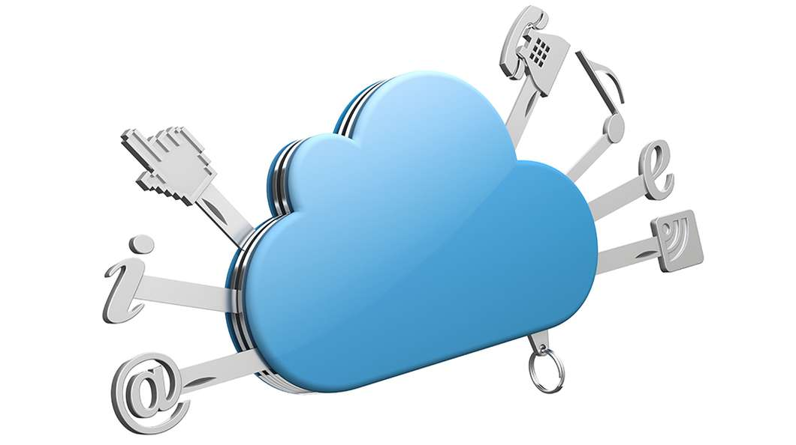

Slide 27
Different Types of the Cloud OS
ZeroPC
JoliCloud
Glide OS
Silve OS
iSpaces Cloud Computer
Cloudo
xOS
ZimDesk
The Places A

Slide 28
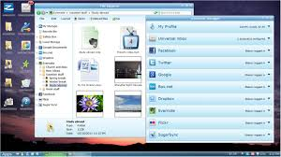
1. ZeroPC
The OS let the connect cloud storage like Dropbox, Google drive, Sky drive for
shared the paperwork.
The OS have some apps like instant messaging, a text editor and tools for
manage documents and share it online.

Slide 29
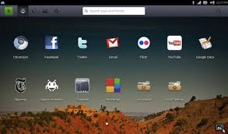
2. JoliCloud
JoliCloud provide the 15000 user application to access the internet and for some
other works.
The Main purpose of the OS is manage all the online life at a single place. The apps
name is “JoliCloud ME”.

Slide 30
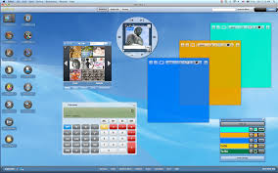
3. Glide OS
The OS have feature like email and basic tools like notes, text editors, presentation
maker and calendar for the use of paper work.
The Main purpose of the OS is to synchronize the files between the OS to HARD DRIVES.

Slide 31
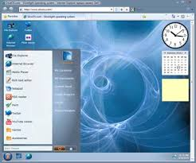
4. SilveOS
The Purpose of the OS is to write documents, listen music, create notes and
play games.
Disadvantages is that OS does not provide any storage to store data.

Slide 32
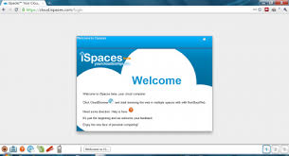
5. iSpaces Cloud Computer
The OS provide some basic feature like File manager, Notes, Browser and office
Suits.
The OS provide its own office suits called ZOHO Office.

Slide 33
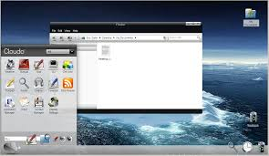
6. Cloudo
The main purpose of the OS is where the commands is run, install
the different apps.
This is the first cloud OS that provides the MULTITASKING features.

Slide 34
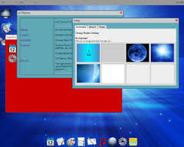
7. xOS
The OS provide the good collection of the apps for personal as well as the
office works.

Slide 35
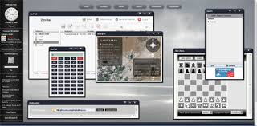
8. ZimDesk
The OS is the full of features and apps. It also provide the custom
wallpaper , contact Manager, FTP Client, Mail client, File manager.

Slide 36
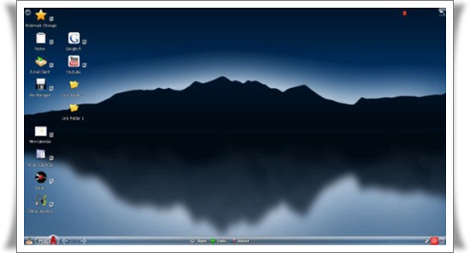
9 . The Places A
The OS provide the basic apps like radio, file manager, notes etc.
The main purpose of the OS is “Instant Messaging” between the user.

Slide 37
Cloud Usage Mechanisms
Cloud usage monitor is a light weight and automatic software program responsible for collecting and processing IT resource usage data.
There are 3 basic agent-based implementations:
Monitoring agent
Resource agent
Polling agent

Slide 38
Monitoring agent: It is an intermediary event driven program that exists as a service to transparently monitor and analyze data flows.
It is typically used to measure network traffic and message metrics.
For e.g. we can consider number of requests a server receives.

Slide 39
2) Resource agent: It is a processing module used to collect the usage statistics by interacting with special resource software.
It collects data based on pre-defined events on resources such as initiating, suspending, resuming and vertical scaling.

Slide 40
Polling agent: A polling agent is a module that collects cloud service usage by polling (asking) the IT resources.
This type of cloud service periodically monitor IT resource
status such as uptime and downtime.

Slide 41
Specialized cloud mechanisms
Based on special runtime functions, there are number of mechanisms
which can be considered as secondary or extensions to cloud infrastructure.
Some mechanisms listed below:
Load balancer
Pay per use monitor
Audit monitor
Failover system
Automated scaling listener

Slide 42
1) Load Balancer:
It is a runtime agent which logically divides workload between different IT resources to increase performance and provide capacity beyond what a single resource can deliver.
It is based on simple division of labor algorithms.
Workload distribution functions include:
1) Asymmetric distribution: Larger workload are issued to resources having larger processing capabilities.
2) Workload prioritization: Workload are scheduled, queued , discarded or distributed according to their priority levels.
3) Content aware distribution: Requests are distributed to different resources as dictated by request content.

Slide 43
Load Balancer can exists as:
-> Multi layer network switch
-> Dedicated hardware appliance
-> Software based system ( built in in server OS)
-> Service agent ( controlled by cloud management software)
Usually, the load balancer is located on communication path as all requests need to be divided from there itself.

Slide 44
Thank you ☺

Slide 45
References
http://searchcloudcomputing.techtarget.com/definition/cloud-computing
http://www.interoute.com/what-iaas
https://en.wikipedia.org/wiki/Cloud_computing#Infrastructure_as_a_service_.28IaaS.29
http://www.thoughtsoncloud.com/2014/02/what-is-platform-as-a-service-paas/
http://www.getcloudservices.com/blog/benefits-and-drawbacks-of-paas/
http://www.cbrdigital.com/2011/05/11/three-types-of-cloud-lock-in.html
Book: Cloud Computing. Concepts ,terminology and architecture
–By Thomas Erl
Pearson
https://en.wikipedia.org/wiki/Cloud_%28operating_system%29
http://www.gizmag.com/transos-cloud-based-operarting-system/24494/
http://www.hongkiat.com/blog/free-cloud-os/
Images from google

